Slide 1

Library Database Analysis

Slide 2
About me
Name: B.Lahari
Background: B.Tech graduate
Why I want to learn Data Science:
I am passionate about uncovering insights from data and using them to solve real-world problems. Data Science excites me because it combines programming, mathematics, and business understanding to drive data-driven decisions.
Profiles:
                ` LinkedIn: [https://www.linkedin.com/in/lahari-battala-7105092b9/]

Slide 3
Objectives
Centralized Data: Store all book, borrower, and branch details in one system.
Book Tracking: Monitor availability, authors, publishers, and branch copies.
Borrower & Loans: Manage borrower info, history, and loan due dates.
Multi-Branch Oversight: Track overdue items and coordinate across branches.

Slide 4
Problem Statement
Libraries handle large volumes of books, multiple branches, and thousands of borrowers. Manual systems often lead to duplication, missing records, and difficulty in tracking book availability or loan status.
This project designs a centralized database that connects publishers, books, authors, branches, borrowers, and loans. It ensures efficient tracking of copies, borrower activity, and due dates, while supporting quick queries and informed decision-making

Slide 5
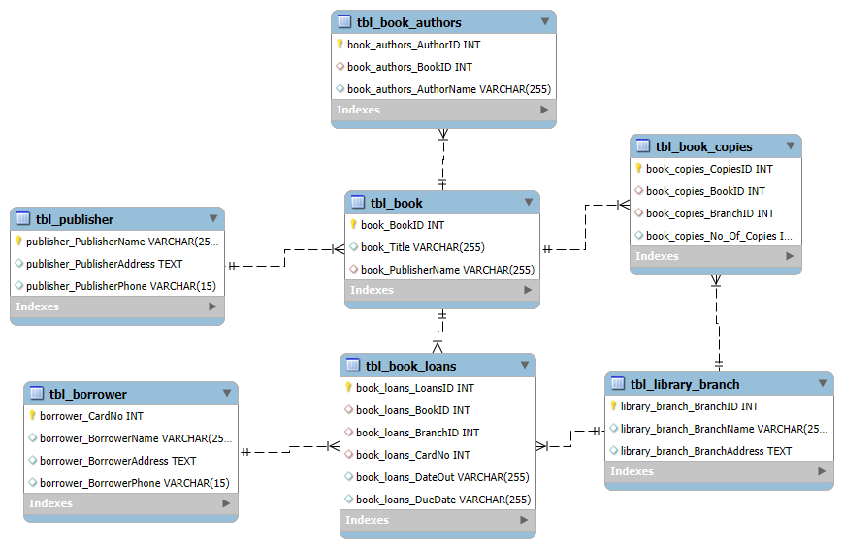
ER Diagram

Slide 6
Schema Explanation
Publisher → Book (1:N)
Book table: BookID, Title, Publisher
Book → Authors (M:N via tbl_book_authors)
Authors table: AuthorID, Name
Book_Authors: BookID + AuthorID
Book → Book Copies (1:N)
Book_Copies: CopyID, BookID, BranchID, No. of Copies
Branch → Book Copies (1:N)
Branch table: BranchID, Name, Address
Book → Book Loans (1:N)
Book_Loans: LoanID, BookID, BranchID, CardNo, DateOut, DueDate
Borrower → Book Loans (1:N)
Borrower table: CardNo, Name, Address, Phone
Branch → Book Loans (1:N)
Each loan record linked to one branch

Slide 7
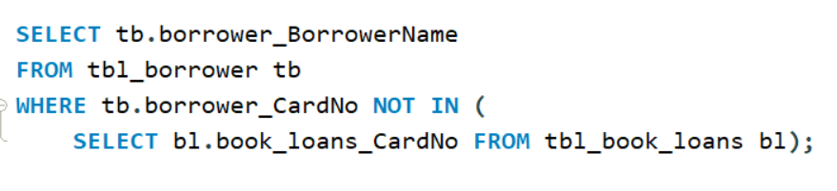
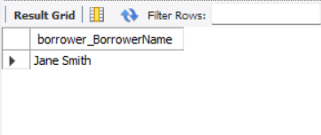
The names of all borrowers who do not have any books checked out

Slide 8
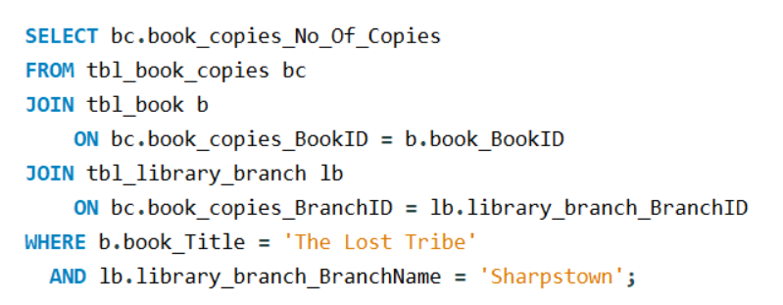
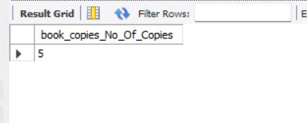
Copies of the book titled "The Lost Tribe" are owned by the library branch whose name is "Sharpstown"

Slide 9
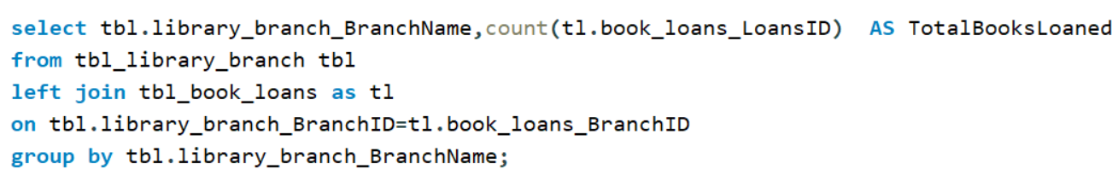
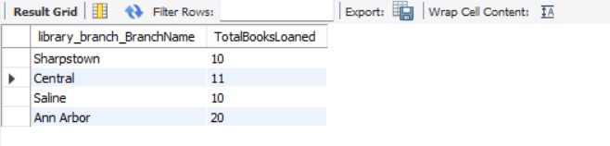
For each library branch, retrieve the branch name and the total number of books loaned out from that branch

Slide 10
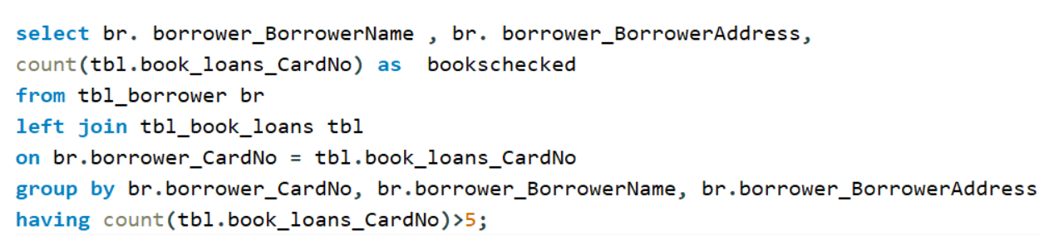
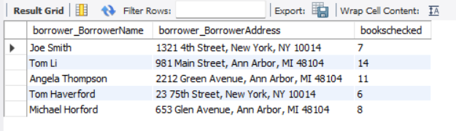
Retrieve the names, addresses, and number of books checked out for all borrowers who have more than five books checked out

Slide 11
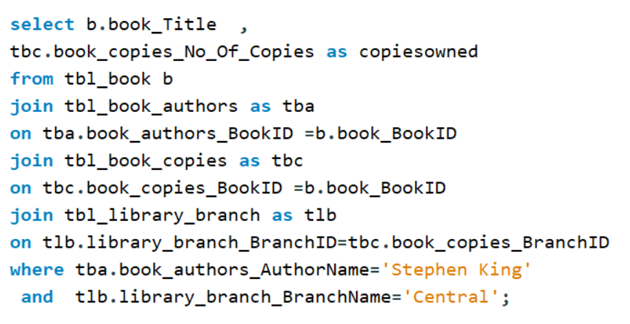
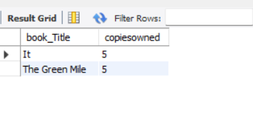
For each book authored by "Stephen King", retrieve the title and the number of copies owned by the library branch whose name is "Central"

Slide 12
Conclusion
This project centralizes disconnected library records into one intelligent database, making book management faster, clearer, and more efficient. It improves multi-branch operations, accelerates searches, and provides actionable insights for smarter decision-making and a better experience for both staff and readers.

Slide 13

THANK YOU

